Slide 1
Certified Defenses for Data Poisoning Attacks
By Steinhardt et al.
Presented by Kyo Kim

Slide 2
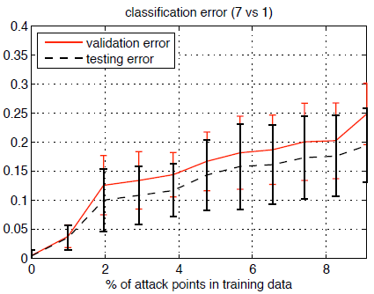
Previously…
Biggio et al. (2012) Poisoning Attacks against Support Vector Machines
Notes:
About a week and half ago, we looked at the effect of poisoning attack on SVM.
As shown on the figure above, we see an increase in the binary classification error as number of attack points.
The context here is that

Slide 3

Can we bound it?
Notes:
Which raises the question, just how bad can it get? Can we bound the effect?

Slide 4
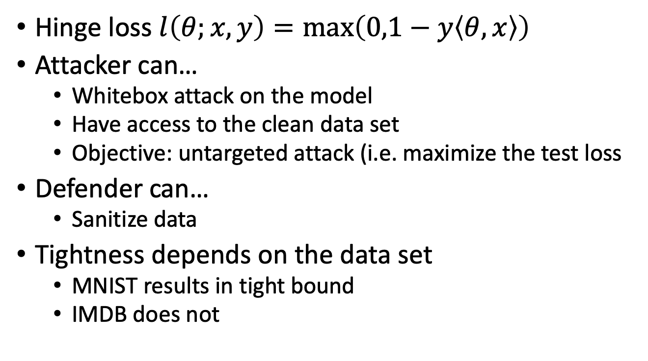

Yes… With Assumptions
Hinge loss $l\left(θ;x,y\right)=\max\left(0,1−y\left\langle θ,x\right\rangle \right)$
Attacker can…
Whitebox attack on the model
Have access to the clean data set
Objective: untargeted attack (i.e. maximize the test loss
Defender can…
Sanitize data
Tightness depends on the data set
MNIST results in tight bound
IMDB does not
$θ$:= model
Notes:
Whitebox attack is reasonable to assume because security by obscurity is a bad security practice.
Paper states “reverse engineer necessary system details” i.e. stealing model

Slide 5
Lets formalize the problem

Slide 6
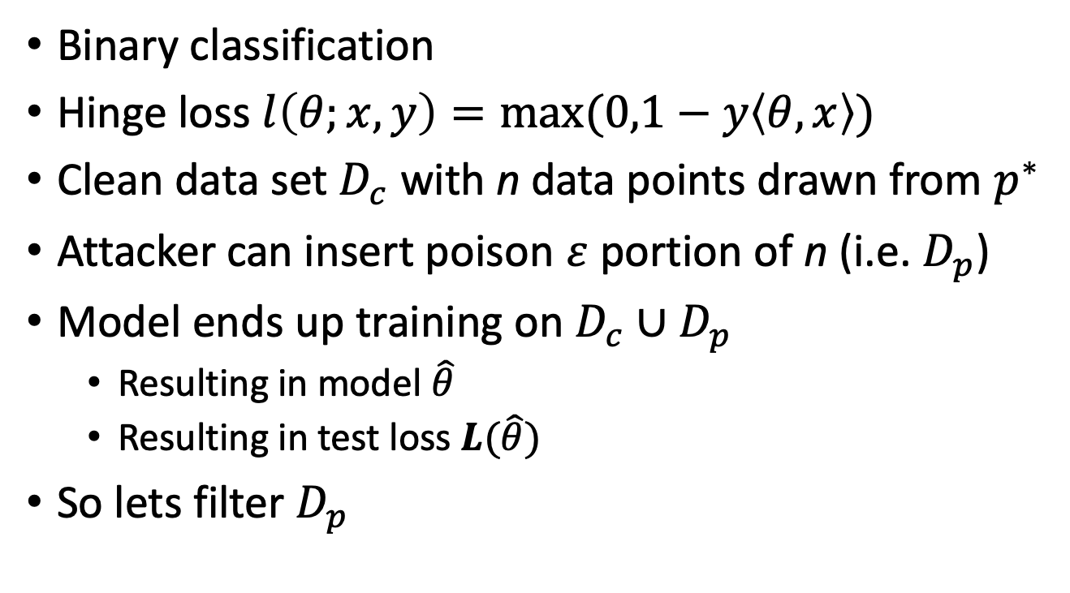
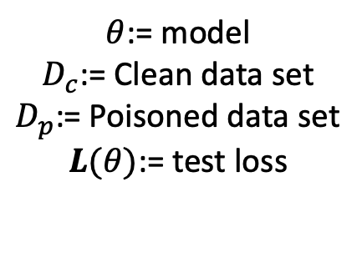
Problem Formalization
Binary classification
Hinge loss $l\left(θ;x,y\right)=max⁡(0,1−y\left\langle θ,x\right\rangle )$
Clean data set $D_{c}$ with n data points drawn from $p^{∗}$
Attacker can insert poison $ε$ portion of n (i.e. $D_{p}$)
Model ends up training on $D_{c}{∪D}_{p}$
Resulting in model $\hat{θ}$
Resulting in test loss $L(\hat{θ})$
So lets filter $D_{p}$
$θ$:= model
$D_{c}$:= Clean data set
$D_{p}$:= Poisoned data set
$L(θ)$:= test loss
Notes:
Naively training on poisoned data set will result in poor model performance.
So lets filter

Slide 7
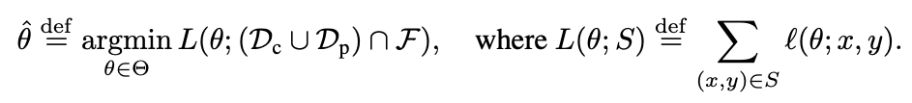


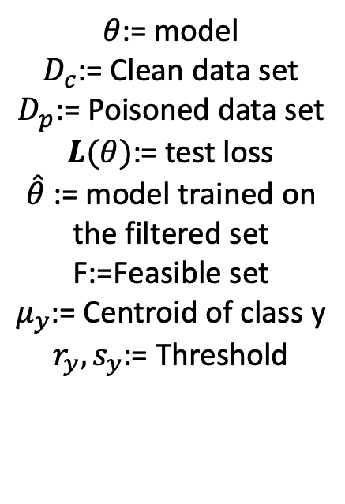
Data Sanitization Methods
Use feasible set F to filter some of poisoned data
Ball filter
Slab filter
$θ$:= model
$D_{c}$:= Clean data set
$D_{p}$:= Poisoned data set
$L(θ)$:= test loss
$\hat{θ}$ := model trained on the filtered set
F:=Feasible set
$μ_{y}$:= Centroid of class y
$r_{y},s_{y}$:= Threshold
Notes:
Lets re-define theta hat.
Model ends up training on ${(D}_{c}{∪D}_{p})∩F$
Resulting in model $\hat{θ}$
Resulting in test loss $L(\hat{θ})$

Slide 8
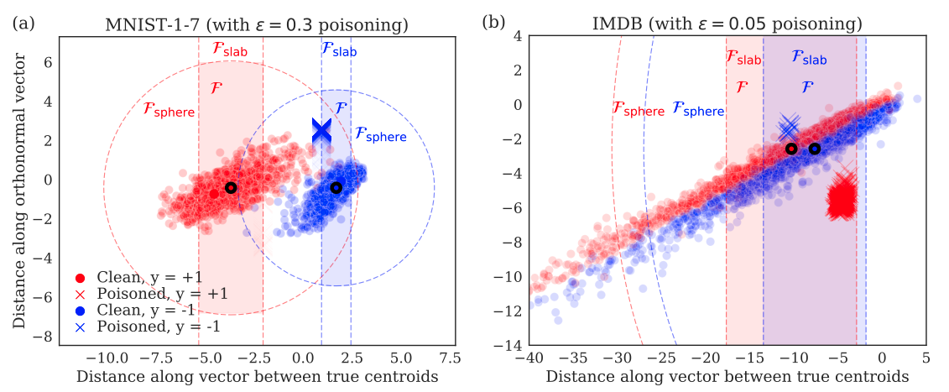
Notes:
Slab and sphere defense such that it keeps 70% of the clean data.

Slide 9
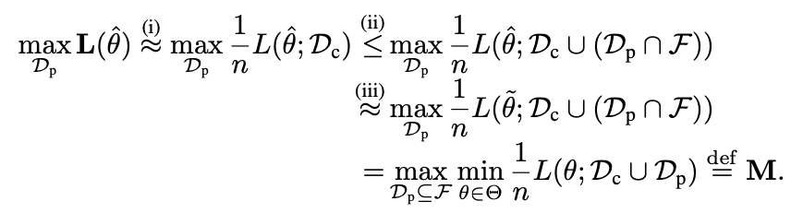
Formally Worst Case Loss is…
Attacker is trying to maximize the loss given the filter F

Slide 10
Formally Worst Case Loss is…
Training and test loss are similar assuming model is regularized.

Slide 11
Formally Worst Case Loss is…
Loss on poisoned data set will always be least great as the clean data set.

Slide 12
Formally Worst Case Loss is…
About the same as minimax loss because minimax has property that will result in optimal attack.

Slide 13
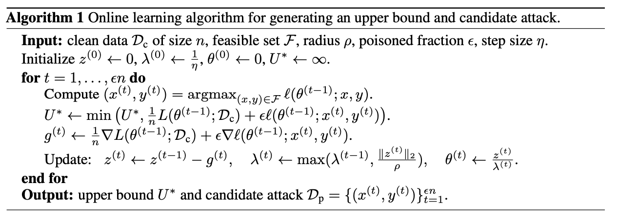
Attack Method
Find worst attack point for each iteration

Slide 14
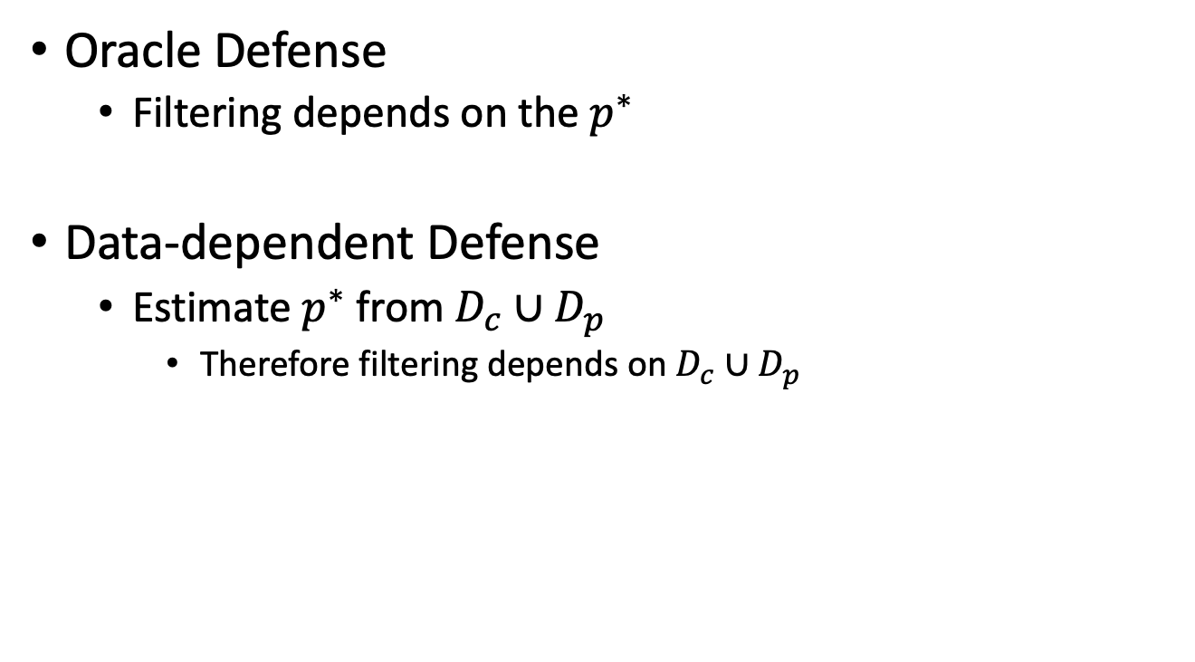
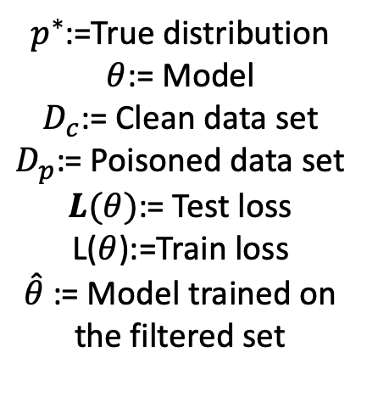
Defense Methods
Oracle Defense
Filtering depends on the $p^{∗}$
Data-dependent Defense
Estimate $p^{∗}$ from $D_{c}{∪D}_{p}$
Therefore filtering depends on $D_{c}{∪D}_{p}$
$p^{∗}$:=True distribution
$θ$:= Model
$D_{c}$:= Clean data set
$D_{p}$:= Poisoned data set
$L(θ)$:= Test loss
L($θ$):=Train loss
$\hat{θ}$ := Model trained on the filtered set

Slide 15
Oracle Defense

Slide 16

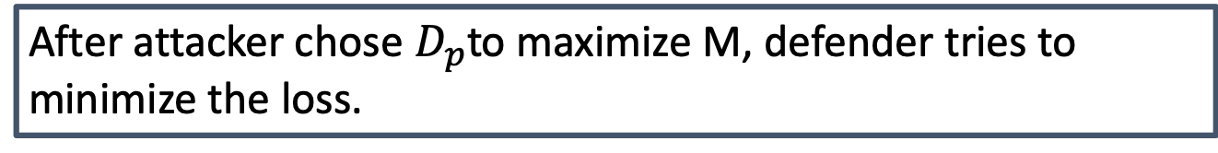
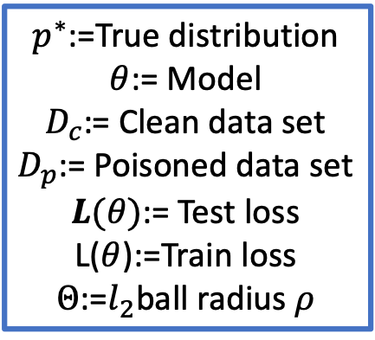
Oracle Defense
F does is not affected by $D_{p}$ (i.e. the set created under no poisoning)
$p^{∗}$:=True distribution
$θ$:= Model
$D_{c}$:= Clean data set
$D_{p}$:= Poisoned data set
$L(θ)$:= Test loss
L($θ$):=Train loss
$Θ$:=$l_{2}$ball radius $ρ$
After attacker chose $D_{p}$to maximize M, defender tries to minimize the loss.
Notes:
Therefore, we flip the minimax.

Slide 17
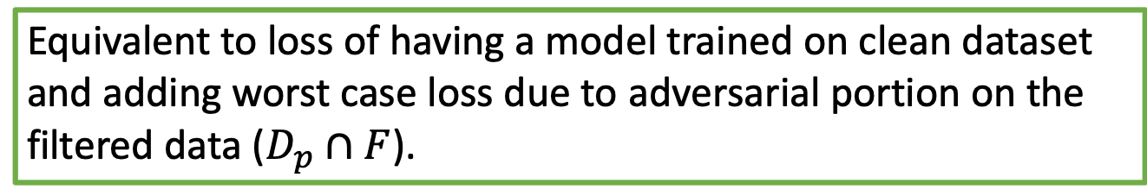

Oracle Defense
Lets bound M
$p^{∗}$:=True distribution
$θ$:= Model
$D_{c}$:= Clean data set
$D_{p}$:= Poisoned data set
$L(θ)$:= Test loss
L($θ$):=Train loss
$ε$:= Portion of adversarial example
Equivalent to loss of having a model trained on clean dataset and adding worst case loss due to adversarial portion on the filtered data ($D_{p}∩F$).
Notes:
Thus flipping the min and max makes sense.

Slide 18
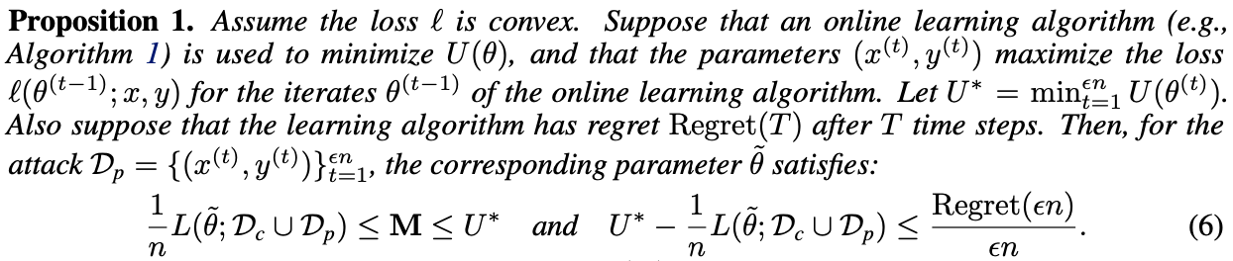
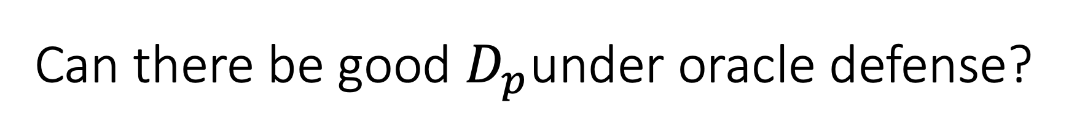
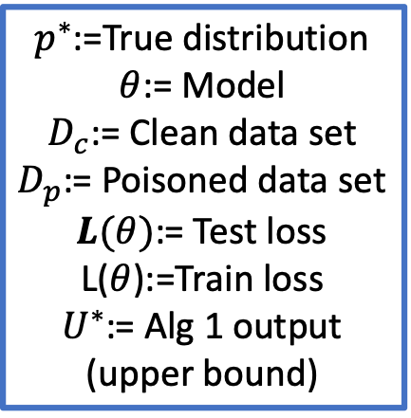
Can there be good $D_{p}$under oracle defense?
$p^{∗}$:=True distribution
$θ$:= Model
$D_{c}$:= Clean data set
$D_{p}$:= Poisoned data set
$L(θ)$:= Test loss
L($θ$):=Train loss
$U^{∗}$:= Alg 1 output (upper bound)
If the average regret is small, then there will be a good $D_{p}$

Slide 19
Data-Dependent Defense

Slide 20

Data-Dependent Defense
F depends on $D_{c}{∪D}_{p}$
${\hat{μ}}_{y}$:= Emperical centroid of class y
$p^{∗}$:=True distribution
$θ$:= Model
$D_{c}$:= Clean data set
$D_{p}$:= Poisoned data set
$L(θ)$:= Test loss
L($θ$):=Train loss
$U^{∗}$:= Alg 1 output (upper bound)

Slide 21
Experiments

Slide 22
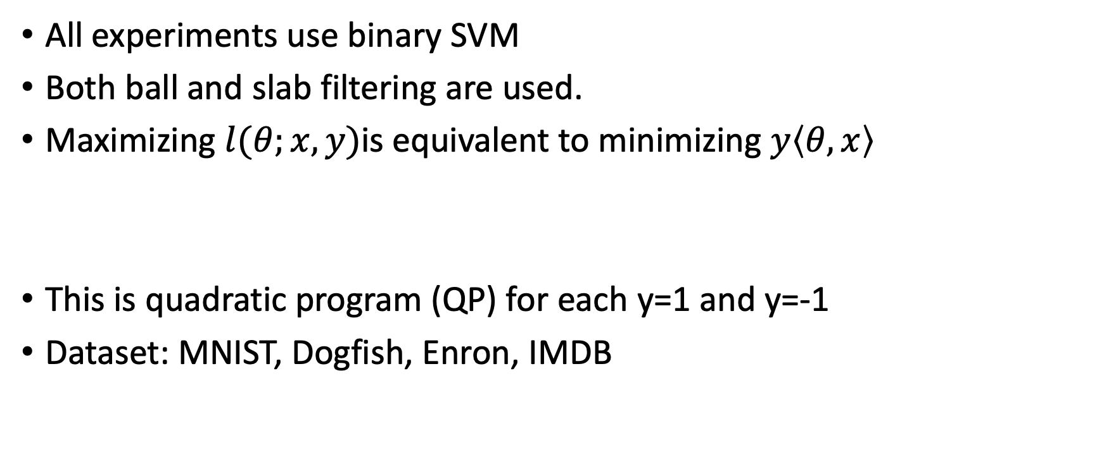
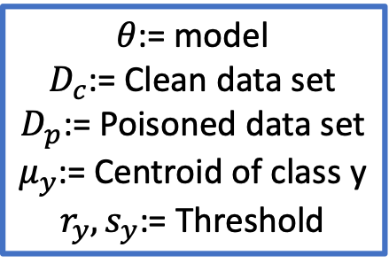
Setup
$θ$:= model
$D_{c}$:= Clean data set
$D_{p}$:= Poisoned data set
$μ_{y}$:= Centroid of class y
$r_{y},s_{y}$:= Threshold
All experiments use binary SVM
Both ball and slab filtering are used.
Maximizing $l(θ;x,y)$is equivalent to minimizing $y\left\langle θ,x\right\rangle$
This is quadratic program (QP) for each y=1 and y=-1
Dataset: MNIST, Dogfish, Enron, IMDB
Notes:
Quadratic program is solved using existing methods such as CVXPY, YALMIP, SeDuMi, Gurobi

Slide 23

Text Dataset
The QP becomes Integer QP (IQP) because $x∈Z_{≥0}^{d}$
Use Gurobi to find approximately optimal feasible x
Valid attack but potentially not optimal
High dimensionality of IMDB

Slide 24
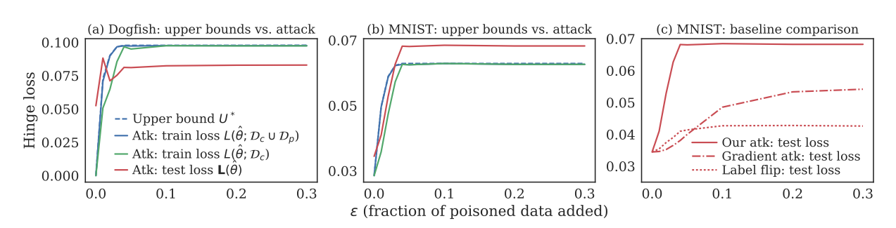
Oracle Defense Result
Notes:
IMDB has large number irrelevant features

Slide 25
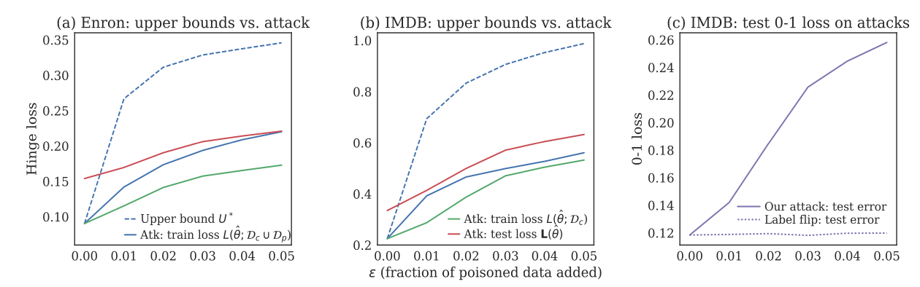
Data-Dependent Defense Result

Slide 26
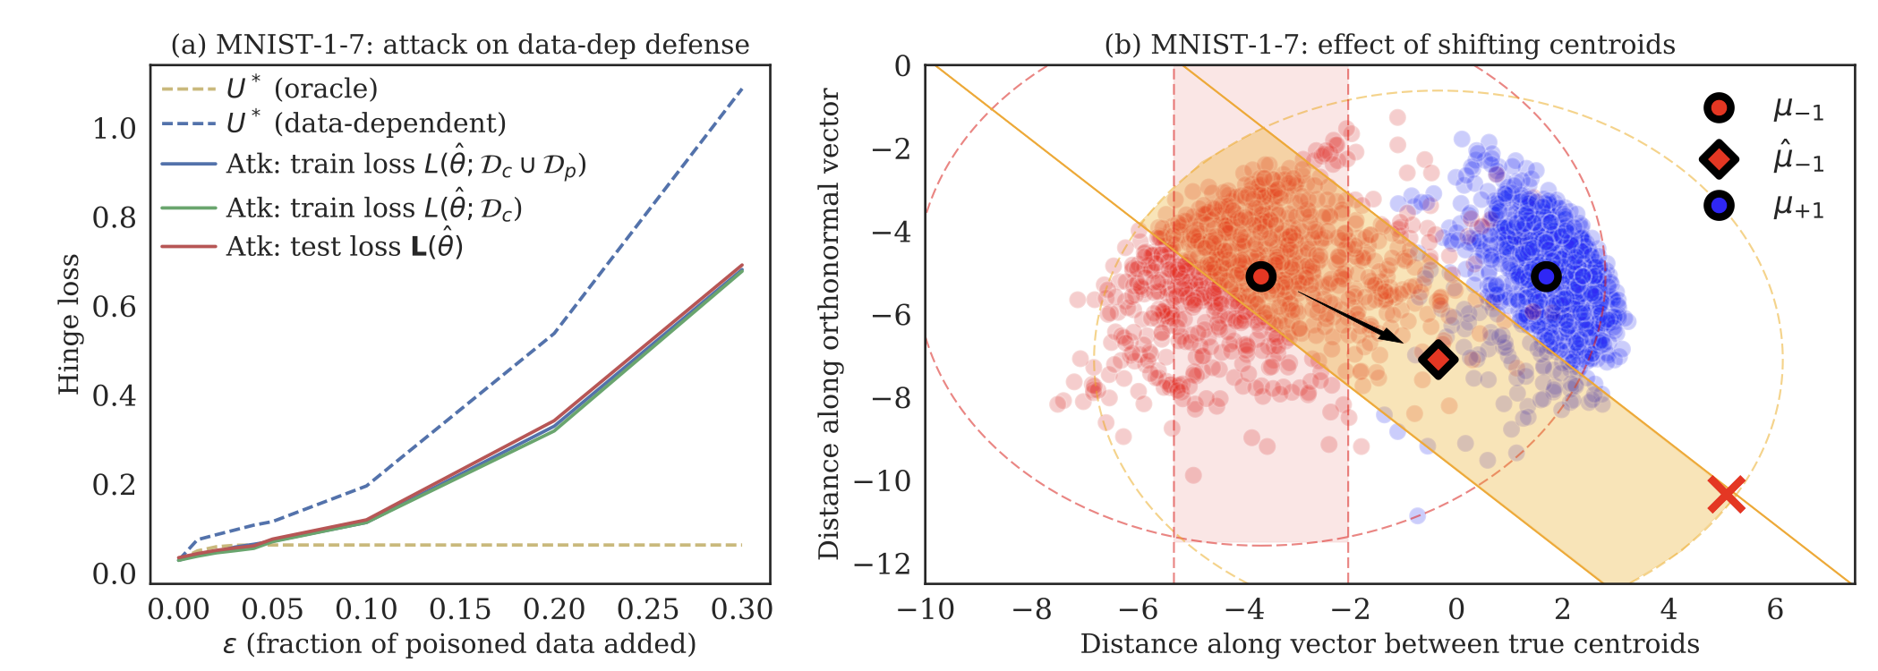
Why does data-dependent defense cause worse bound?

Slide 27
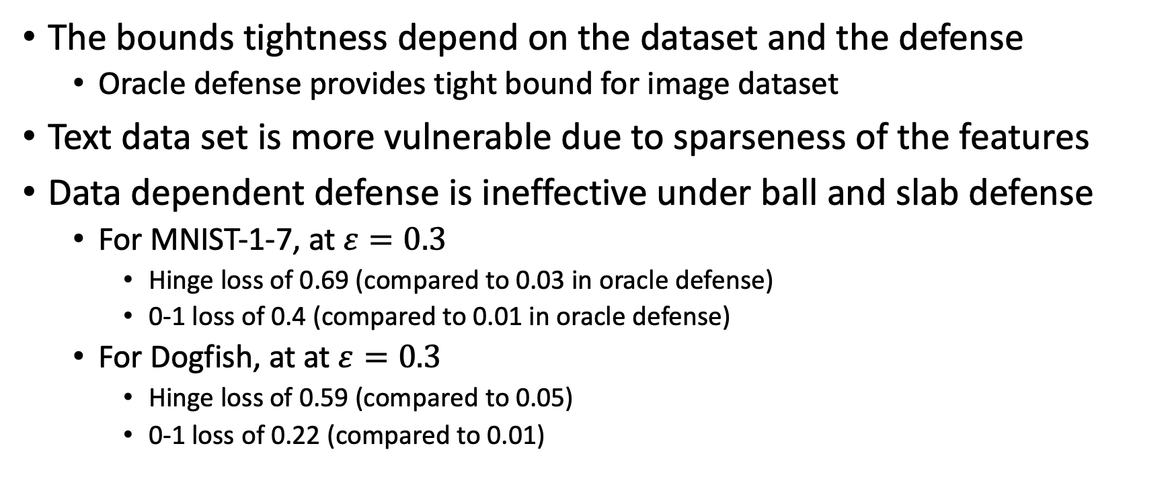
Takeaway
The bounds tightness depend on the dataset and the defense
Oracle defense provides tight bound for image dataset
Text data set is more vulnerable due to sparseness of the features
Data dependent defense is ineffective under ball and slab defense
For MNIST-1-7, at $ε=0.3$
Hinge loss of 0.69 (compared to 0.03 in oracle defense)
0-1 loss of 0.4 (compared to 0.01 in oracle defense)
For Dogfish, at at $ε=0.3$
Hinge loss of 0.59 (compared to 0.05)
0-1 loss of 0.22 (compared to 0.01)

